Slide 1

Advanced Equations using SolidWorks API and VBA Code
Josh Brady, Advanced Specialist
Denso Manufacturing Tennessee, Machinery & Tools Division

Slide 2

Design Automation – The “Tools”
Several “tools” are available for automating the design process:
 | Macro | Design Table | Equation
Pros | Most powerful All document types Control anything Re-use on any document | Very powerful Change geometry and custom properties. All Excel functionality available for automation Travels with document | Evaluates with every rebuild Travels with document Can be saved in a template
Cons | User must run Macro does not travel with document | Requires MS Excel User must edit table to evaluate XL functions Part/Assembly only | Mostly limited to geometry change Part/Assembly only
Equations appear to be the least powerful.
  Main advantage: Evaluate with every rebuild.
By embedding VBA into equations, they gain some of the power of macros

Slide 3
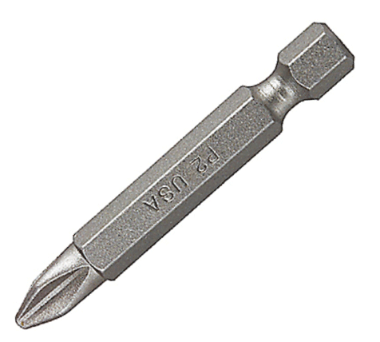
Specialized “Bits” for the Equation “Tool”
The drive bit: VBA functions
  Introduction
  Simple useful functions and syntax
  Object variables
    Automatically populated object variables
    Accessing other objects
  More complex functions
  Tips and cautions
The extension bit: Direct referencing of custom properties
  Enables multiline macros to execute in equations

Slide 4
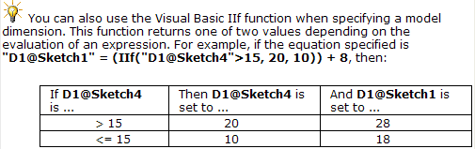
The Drive Bit – VBA Functions – Introduction
SolidWorks help file states that VBA “IIF” statement can be used:
Question: If this function can be used, are there any others that work?
  Answer: Yes, almost any VBA can be used in an equation!
    Message boxes
    String manipulation functions
    Logical operators (Not, And, Or, etc)
    SW API functions
  The equation must keep the form of a SolidWorks equation
  The value on either side of the “=“ doesn’t have to mean anything!

Slide 5
The Drive Bit – VBA Functions – Simple Useful Functions and Syntax
The MsgBox function
  VBA’s “Hello World” program
  Not very useful in equations except for debugging/demonstration
The IIF function
  Syntax very similar to Excel’s IF() worksheet function
  Mentioned with example in SolidWorks help file
  Can’t use “=“ comparisons
    This is a limitation of SolidWorks equation syntax. Equations can contain only one “=“.
    “Like” operator can usually be used for “=“.
  Can be nested
    Nesting depth limited only by SolidWorks maximum equation length of 512 characters
Logical operators
  Syntax different from Excel’s logical worksheet functions.
    Excel: OR(Arg1, Arg2)
    VBA: Arg1 Or Arg2
IntroEquations.sldprt, Eq#1
IntroEquations.sldprt, Eq#2
IntroEquations.sldprt, Eq#3
IntroEquations.sldprt, Eq#4
IntroEquations.sldprt, Eq#5
IntroEquations.sldprt, Eq#6

Slide 6
The Drive Bit – VBA Functions – Object Variables
Almost any useful task in VBA requires use of objects.
Automatically populated object variables
  In the context of equations, three objects are already populated
    Application (Usually only used as Application.SldWorks)
    swApp (object of the type SldWorks.SldWorks) – The current SolidWorks session
    Part or Assembly (object of the type PartDoc or AssemblyDoc) – The document containing the equation
  At the time an equation is evaluated, “Part” and “swApp.ActiveDoc” may not refer to the same document!
    A component containing an equation may be rebuilt while another document (e.g. assembly) is active.
    Using “Part” or “Assembly” in an equation ensures that the document containing the equation is the one that is affected by the equation.
Accessing other objects
  Most application or document objects can be accessed by “stringing together” all accessors into one line
    Part.Extension.CustomPropertyManager("").Get("MyCustomProperty")
Objects-Part.sldprt, Eq#1 & 2
Objects-Assm.sldasm, Eq#1
Objects-Part.sldprt, Eq#3
Objects-Part.sldprt, Eq#4

Slide 7
The Drive Bit – VBA Functions – More Complex Functions
“::” can be used to pack multiple lines of code into a one-line equation
  Still cannot use “=“
  Still subject to 512 character length limit
ShowSmartMessage is a more useful substitute for MsgBox
  Appears as ToolTip, no user interaction required
Getting/Setting custom properties
  Use the CustomPropertyManager object
    Can get or set document-level or configuration-specific custom properties.
      Use Part.ConfigurationManager.ActiveConfiguration.Name to specify the configuration for Part.Extension.CustomPropertyManager
    Need to break up property name into pieces, “MyPro” & “pertyName”
    Property must already exist to set
    Can delete then add a property to ensure it exists
    Can use VBA functions to manipulate or parse filenames and other default properties
Objects-Part.sldprt, Eq#5
Objects-Part.sldprt, Eq#6
Objects-Part.sldprt, Eq#7
Objects-Part.sldprt, Eq#8
Objects-Part.sldprt, Eq#9
Objects-Part.sldprt, Eq#10
Objects-Part.sldprt, Eq#11

Slide 8
The Drive Bit – VBA Functions – Tips and Cautions
Debugging can be difficult – No information about errors
  More complicated code can be debugged as a macro in the VBA IDE
    Add a few lines to recreate the equation’s pre-defined variables
    Start with short simple lines, then combine to single line
  Runtime errors cause code to stop with no error report to the user
Equations are evaluated by SolidWorks more than once in each rebuild.
  As the number of equations increases, each is evaluated more times.
Flow control is difficult to impossible (branching, looping, GOTO, etc)
  IIF statement does not actually branch code execution.
    Both the True and False statements always execute every time.
  Loops are difficult to create without using “=“
SolidWorks will crash to desktop if code triggers rebuild loop
  Custom property changes are safe, geometry changes less safe
  Save often when working on a complicated equation
Objects-Part.sldprt, Eq#12
Objects-Part.sldprt, Eq#13

Slide 9
The Drive Bit – VBA Functions – Tips and Cautions
The “Special Values Filter”
  Intended to allow file properties and custom properties to be referenced in normal equations
  Operates before VBA interpreter
  Not case-sensitive for dimensions and default property names, case sensitive for custom property names.
  Break apart custom property names to get them through this filter
Equation
“Result”=“D1@Sketch1” * “SW-Density” * “SomeProperty” - 30
Special Values Filter
“D1@Sketch1” →50 “SW-Density” →0.01 “SomeProperty” →100
Equation
“Result”=50 * 0.01 * 100 - 30
Objects-Part.sldprt, Eq#14

Slide 10
The Extension Bit – Direct Referencing of Custom Properties
The “Special Values Filter” can insert entire, multiline code blocks from a custom property into an equation before it is passed to the VBA interpreter.
  Many of the previously outlined limitations do not apply when code is stored in a custom property.
    Multiline code actually has line breaks rather than being separated by “::”
    No 512 character limit
    Can use “=“ assignment operator
    Full flow control – branching, looping, GoTo, etc.
    No need to “break up” custom property names – “Special Values Filter” not recursive
  Some new/different limitations do apply
    Can’t use comments in the body of the property. Code stops executing at the first comment encountered.
    Custom property length is limited to 1023 characters by SolidWorks. However, multiple properties can be concatenated to get around this limit.
    Can’t write and call subs or functions – everything must be in one block of code
    Can’t create forms
    Can’t listen for events
    Can’t trap for errors with “On Error GoTo”…
Objects-Part.sldprt, Eq#15
CodePayload.txt
Objects-Part.sldprt, Eq#16

Slide 11
The Extension Bit – Direct Referencing of Custom Properties
With just a small amount of care, the entire code block can be written and debugged in the VBA IDE as a macro, then pasted into the custom property.
A simple multiline property editing macro makes pasting and tweaking easier
Possible to branch code so that it does not execute multiple times during one rebuild.
Code embedded in one document’s equation can modify other documents.
  Example: Assembly equation updates quantity custom property of all its component documents
SampleAssembly.sldasm

